Slide 1
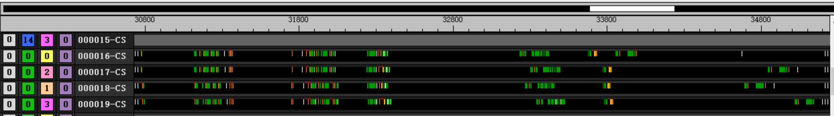
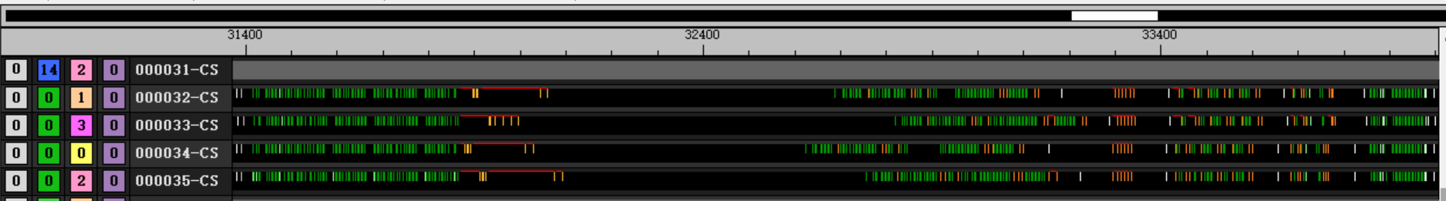
Weekly
optimization
Multi-pass optimization：
Origin multi-pass use different function for each pass
Every pass will have instruction cache miss
loop a same function for multiple passes (except first and last pass)
No loop
Loop：2600 clk

Slide 2
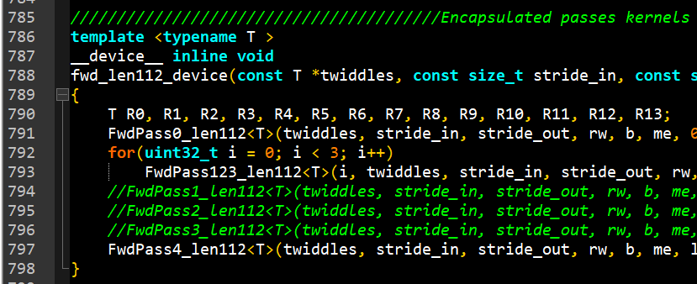
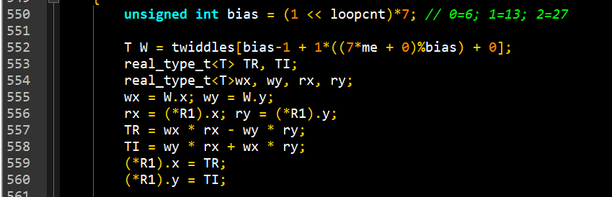
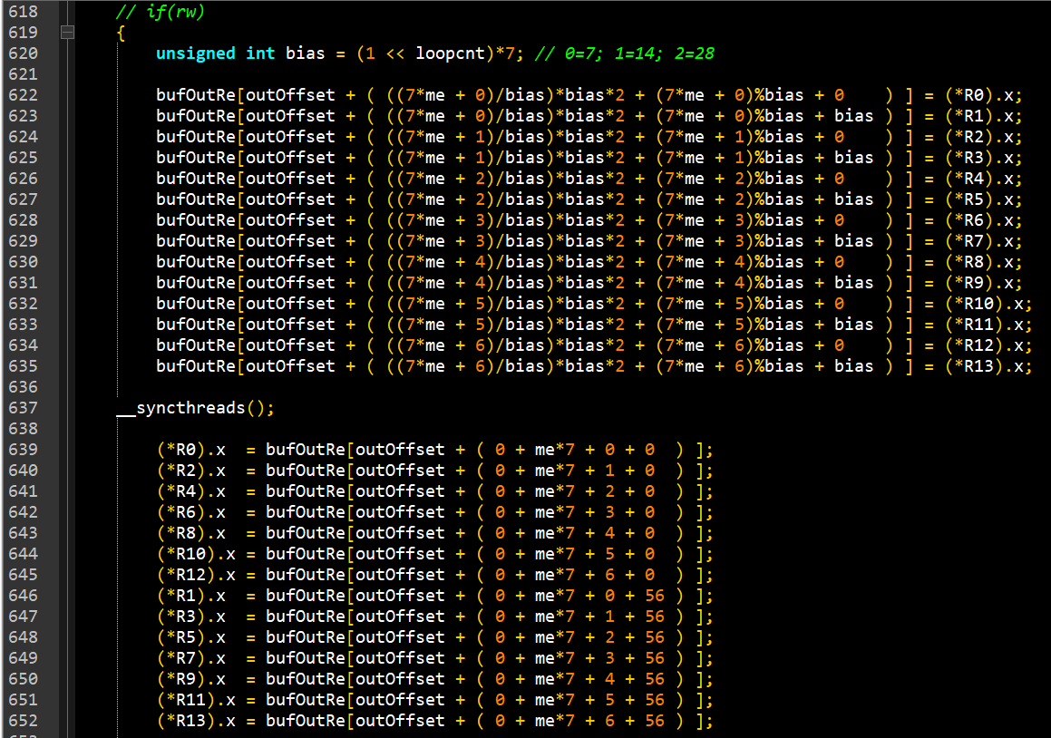
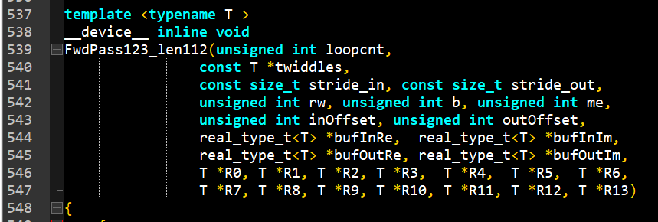
Weekly
optimization
Multi-pass optimization：

Slide 3
Weekly
optimization
Multi-pass optimization：
Performance
length | radix | Pass number | Group number | before | after
112 | 7 | 5 | 480 | 0.013ms | 0.012ms
512 | 8 | 3 | No need | - | -
2187 | 3 | 7 | 60 | 0.016ms | 0.017ms
3125 | 5 | 5
4096 | 16 | 3 | No need

